Slide 1
Learning & Development Enabling development, Impacting growth…
Cognos 11 (IBM Cognos Analytics) – Training
Framework Manager
Cognos Admin & Security

Slide 2
Module Objectives :
Framework Manager
Designing a project
Create Namespace, folders, Query Subject, Query Items
Create Relationships and Define Cardinality
Create Filters, Calculations
Create Regular and Measure Dimension
Create Hierarchy (DMR)
Create and Publish package
Defining Usage Property
FM Security
Parameter Maps, Session Parameter, Macro Functions
Define Query Set
Branching & Merging
Governor Settings
Cognos Administration
Manage Accounts, Activities, Contents
Manage & Create Data servers
Manage system configuration setting
Create & schedule jobs
Administration Console, Monitoring and Performance Tuning
Security
Authentication Provider
Cognos Namespace
Initial Security
Built-in entries
Pre-defined entries
Pre-defined roles
Specify Security settings after installation
Demonstration: To Remove Everyone from System Administrator
Optimizing Users, Groups, and Roles in the Cognos Namespace

Slide 3
Corporate Performance Management System
PERFORMANCE
MANAGEMENT
SOLUTIONS
Industry Solutions
Enterprise Performance Solutions
BEST PRACTICES
How are we doing ?
Why are we doing it?
What should we be doing ?
PERFORMANCE MANAGEMENT PLATFORM
Metrics Management
Query & Reporting
Event Management
Dashboarding
Analysis
Planning
PLATFORM SERVICES
Information & Business Modelling
Data Integration
Portal
Security
Configuration
Administration
Operational or Star Schema
OLAP
Enterprise Applications
Flat, Modern and Legacy

Slide 4
Business Intelligence
Business Intelligence (BI) applications enable businesses to gather, store, analyze, integrate, and present business data.
Better Decision Making
Reporting and Analysis of BI data enables businesses to make better and efficient decisions.
Efficient Management
Provides historical, current and future business operations data that enable to manage businesses efficiently.
Quality Data
BI applications use data stored in a data warehouse or data mart..
Software Element Support
Software elements support the use of this information by assisting in the extraction, analysis, and reporting of information.

Slide 5
Framework Manager
Framework Manager is a metadata modeling tool.
It takes data from various data sources and creates a data model customized for reporting or analysis needs.
It is a Windows-based client tool that you can use to create simplified business presentations of metadata that are derived from one or more data sources.
Metadata Model is a collection of metadata that is imported into the framework manager from one or more data sources.
This metadata model is published as a package to the IBM Cognos BI portal
When you add security and multilingual capabilities to this business presentation, one model can serve the reporting, ad hoc querying, and analysis needs of many groups of users around the globe.
IBM Cognos BI Portal
IBM Cognos Metadata Model
(Framework Manager)
Relational
Cubes
Files
Other

Slide 6
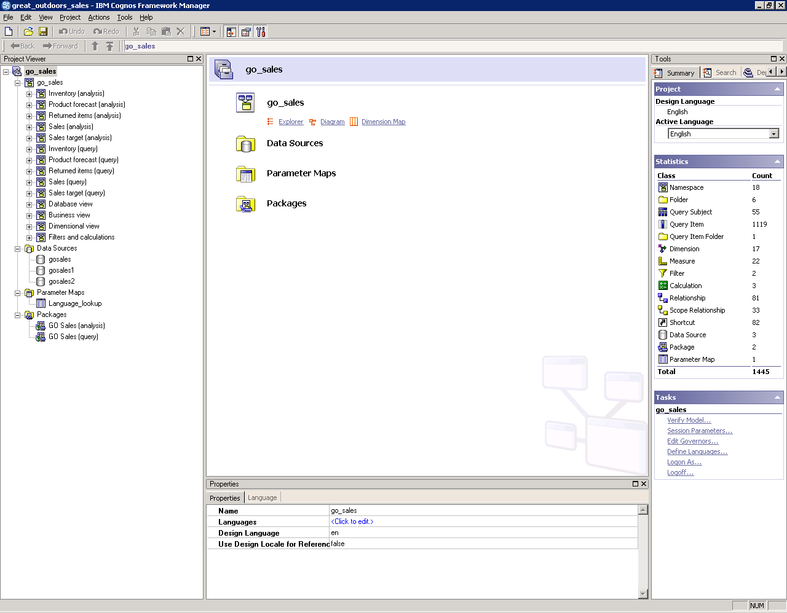
Framework Manager (contd…)
Notes:
6

Slide 7
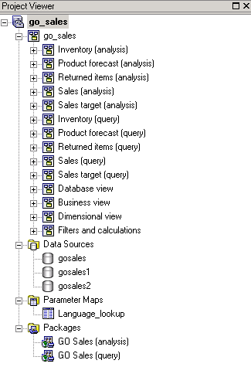
Framework Manager (contd…)
Project
A project is an instance which is opened once a Framework Manager is started.
A project at high level contains the following objects:
A Model
Namespaces
Data Sources
Parameter Maps
Packages
Notes:
7

Slide 8
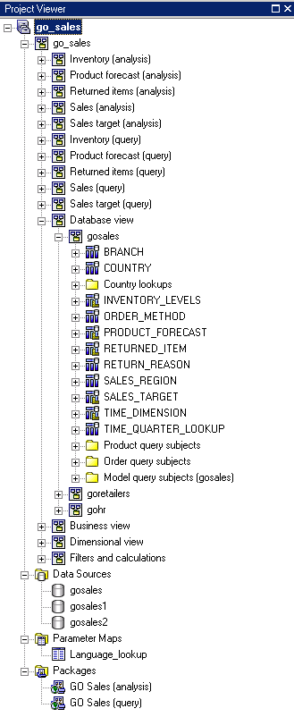
Framework Manager (contd…)
Metadata Elements
In a Framework Manager project, metadata is defined and organized by the following objects:
Model
Namespace:
Folder
Query subject
Query item
Relationship
Parameter map
Package
Notes:
8

Slide 9

Framework Manager (contd…)
Project Files
A project appears in a file system as a folder that contains a project file (.cpf) and XML files.
X.cpf: Project file references to define the business model.
Model.xml: Actual model data created by Framework Manager developer.
Preferences.xml: Preferences for Framework Manager Projects.
Customdata.xml: Stores diagram information, layout, fonts and colors.
Repository.xml: Logged version of the History for each project or segment added to the repository.
When a package is published, the server compiles the XML specification into binary runtime information.
Various files of a model
Notes:
9

Slide 10
Framework Manager (contd…)
Project – Query Subject Types
Data source query subject
SQL query that acts as a view into the underlying query data source.
Default data source query subjects are created based on imported objects.
Model query subject
Contains query items based on other existing objects in the model.
Enables simplification of the model for business views.
Provides a way to control Query Generation.
Enable users to override the settings specified for the data sources query subjects to meet reporting requirements.
Stored procedure query subject
Contains query items based on the return list of a stored procedure
Notes:
10
The most important component of the Framework Manager project is the query subject. A project is built upon query subjects. There are several types of query subjects:
Data Source Query Subject
The data source query subject is an SQL query that acts as a view into the underlying query database(s). During the initial metadata import operation, a default data source query subject is created for each object you select and creates the default relationships between query subjects for you automatically. Note: A query subject that is based on a table uses the following general SQL syntax: select * from <table>
Model Query Subject
The model query subject allows you to define the business presentation for the users. Model query subjects can contain query items from other existing objects in the model. Model query subjects can be enhanced even further, perhaps by adding filters or calculations to create more query items. You can also use query subjects from other model query subjects.
Stored Procedure Query Subject
The stored procedure query subject contains query items based on the return list of a database stored procedure.

Slide 11

Framework Manager (contd…)
Workflow
Data Sources
Design/Create Project
Prepare Metadata
Prepare Business View
Create & Manage Packages
Manage Project
Publish
Set Security
Report Studio
Analysis Studio
Query Studio
Content Store
Notes:
11
Before report authors can create reports, you must follow a process in Framework Manager:
Design and create project
Foundation for the modeling process
Prepare Metadata
Clean up, Administer, Present
Prepare the Business View
Add business value specific to reporting requirements (e.g., calculations, filters, prompting)‏
Create and Manage Packages
Identify subsets of the metadata to be published
Set Security
Based on ReportNet security
Set at the package level
Publish
To the ReportNet server for use by report authors to create reports
Note: this graphic shows the FM workflow process, with Publishing models as the final task. For the purposes of course flow we will be publishing models in the demos and workshops in each module. This is to view the results of modifications made to the models, right away, instead of waiting until the end (of a 3 day course) to view them. Otherwise, students may not remember what they have modeled on a previous day, and may not recognize those changes reflected in the reports and queries created in QS and/or RS.
Manage the Project
To be performed throughout the modeling process.
Set of project management features:
to enable multi-user modeling
maintain version control
Link & segment → organize a project according to business rules and organizational needs and allow other users to access sections of the project
to manage the project
specify query processing
define function sets
verify the project for errors or problems

Slide 12
Framework Manager (contd…)
Analyze and Design
Know your data and the structure of your data sources.
Work with report authors to understand business reporting requirements.
Identify the project structure.
Create
Create a project.
Import the required metadata.
Organize
Organize objects to create a physical view of the metadata.
Design/Create Project
Notes:
12
Design
Ensure that you know your data and the structure of your data source(s).
Analyze and understand your reporting requirements before you begin.
Identify project structure
Metadata
Data source type, locations, connections
Organization
Two tier model
Create
Create a project
Establish file system location for project files
Import the required metadata
You should import only what you need (tables, relationships) -→ see design

Slide 13
Framework Manager (contd…)
Naming Conventions
Objects in Framework Manager must consists of the following:
An identifier
The same name but must be uniquely identified using a namespace
The identifier can consist of one, two, or three parts, for example:
Query items have a three-part identifier
Example, [GoSales].[Product].[ProductCode]
Namespaces, functions, shortcuts to namespaces, and shortcuts to folders have a one-part identifier
Example, [GoSales]
All other objects have a two-part identifier
Example, query subjects:[GoSales].[Product]
Notes:
13
Naming Conventions for Objects in a Project
All objects in a project have an identifier that is used to reference them. The identifier can consist of one, two, or three parts, depending upon the type of object. The parts include
an object name, and
a location in the project hierarchy, as expressed in the default language of the project.
If you want to have objects with the same name in a project, these objects need a unique identifier. To create a unique identifier for an object, you must create a namespace.
One-part Identifiers
Some objects in a project have a one-part identifier. The one-part identifier must be unique across the entire project, even if the namespace contains other namespaces. These are the objects that have a one-part identifier:
Namespaces
Functions
Shortcuts to namespaces
Shortcuts to folders
Three-part Identifiers
Some objects in a project have a three-part identifier. The three-part identifier is based on the identifier of the containing query subject. Each name must be unique in the containing query subject. These are the objects that have a three-part identifier:
query items
query item folders
For example, you have a GoSales namespace that contains a query subject named Product, and a query item named Product Code. The Product Code query item has the following name, where the square brackets and periods are the syntax Framework Manager uses for object identifiers.
[Go Sales].[Product].[Product Code]
Two-part Identifiers
Most of the objects in a Framework Manager project have a two-part identifier. The two-part identifier consists of the name of the containing namespace and the name of the object. The object name must be unique in the nearest containing namespace. For example, you have a GoSales namespace that contains a query subject named Product. The Product query subject has the following name, where the square brackets and periods are the syntax Framework Manager uses for object identifiers.
[Go Sales].[Product]

Slide 14
Framework Manager (contd…)
Administer
Specify query processing type.
Define function sets.
Clean Up
Examine and modify object properties.
Examine, modify, and create relationships.
Edit SQL.
Add Multilingual support.
Prepare Metadata
Notes:
14
Examine and modify object properties (e.g., names, descriptions)‏
Verify the usage and regular Aggregate property values of each query item, especially if the usage is set to "fact".
Examine and resolve ambiguous relationships (remove redundant relationships, modify cardinality)‏
Create relationships (e.g. between two data sources)‏
It is best practice to create relationships only in the data-source layer.
Edit SQL
Specify query processing type (local vs. database)‏
Defining function sets
Create a two tier model
Create folders that separate query subjects into physical and presentation layers
Add query subjects to the presentation layer that are based on query subjects in the physical layer
Then organize and model objects to provide the business view of the metadata

Slide 15
Framework Manager (contd…)
Prepare Metadata
Usage Property:
Identifier – A column to group or summarize the data with which it has relationship, such as, Index columns, Date, time columns. Product Number and Date of Joining.
Fact - Column contains numeric data and can be a group or summarize, such as, Product cost and Date ranges.
Attribute - A column which is neither a fact or Identifier, such as description, Product name.
Unknown - Not defined in the usage properties.
Cardinality:
0..1 : Zero occurrences to one occurrences
1..n: One occurrence to Multi occurrences
0…1: Zero occurrence to one occurrence
1…1:Must have one occurrence.
(0/1): Optional or Mandatory.
(1/n): Minimum or Maximum.

Slide 16
Framework Manager (contd…)
Determinants
A determinant is the set of query items that can be used to uniquely identify a set of data.
Determinants are imported based on key and index information in the data source.
We recommend that you always review the determinants that are imported.
Model query subjects do not have determinants defined for them automatically. If determinants are needed, you must define them manually.
Stored procedure query subjects do not have determinants.
You cannot use determinants with user-entered SQL.

Slide 17
Framework Manager (contd…)

Slide 18
Framework Manager (contd…)
To enhance the business view of the model, you can:
Create one or more presentation views
Add calculations
Create and apply filters
Add prompts
Create dynamic queries
Use star schema groupings
Specify Determinants
Model dimensionally of OLAP style queries
Prepare Business View
Notes:
18
You can add business rules to the query subjects in your model to refine the data retrieved and ensure that the right information is available for report authors. You can
add calculations so that report authors can include calculated data in their reports
create and apply filters so that you can limit the data that a query subject retrieves
add prompts so that users are prompted to filter data when they open a report
use session parameters and parameter maps to create dynamic queries
Use star schema groups to isolate fact tables that share conformed dimension(s) → ADVANCED – see Module 8
Specify dimensional information → ADVANCED – see Module 8
I.G. note: There may seem a crossover between modeling tasks performed in the Business View preparation and Metadata preparation phases of the workflow process. For example, although we describe adding calculations as part of the Business View preparation phase, this is a modeling technique that can be performed in the Database layer. However, we describe creating the Database layer (as part of creating a two tier model) in the Metadata preparation phase. It is important to emphasize that the workflow process is iterative and not necessarily linear. As such, the tasks we describe in each of the phases are unique to each phase, but that they may occur at different times during the modeling process.

Slide 19
Framework Manager (contd…)
Business View Preparation
Calculations:
To add calculated columns, use the following for calculations:
Query items
Parameters
Functions
Filters:
There are two types of User Interface filters available in Framework manager.
Stand-alone: Reusable in multiple Query Subjects
Embedded: For a Single Query Subject

Slide 20
Framework Manager (contd…)
To create and manage packages, you can:
Define the package contents
Modify a package
Specify languages
Set governors
View package inclusion
Enable versioning
Create & Manage Packages
Notes:
20
Define the package(s) to be published to the ReportNet server.
Each package contains the query subjects required to meet a reporting need
Modify a Package – select, hide, unselect
Specify Languages – what languages will the report authors be able to see
Set Governors – set data retrieval limits
Explore packages– identify what is hidden, selected/unselected in a package
View package inclusion – select an object and identify which package(s) has been included in Publish a Package
publish packages to the ReportNet server or to a network location
enable versioning

Slide 21
Framework Manager (contd…)
Cognos 11 security is implemented through user authentication and authorized access to content.
To set security in Framework Manager, you can:
Define access to packages
Create security filters
Define access to objects
Define package administration access
Set Security
Notes:
21
Access to the packages - apply security to a package and identify the user who has access to that package
Security filters – enable row security by creating a security filter that is applied to a specific query subject; the filter controls the data that is shown to report authors when they set up their reports
Access to objects – enable column security by either making an object visible or hiding it.
Package Admin Access – applying security on who can publish and perform other administration

Slide 22
Framework Manager (contd…)
Perform project management activities such as:
Implementing multiuser modeling
Repository control
Sharing and reusing information
Segmenting and linking
Action logging and synchronizing
Project verification
Manage Project
Notes:
22

Slide 23
Framework Manager (contd…)
A relational data source should be dimensionally modeled when you want to do one or more of the following:
Use Analysis Studio
Enable drill functionality in reports
Access member functions in the report authoring tools
Notes:
Regular dimensions represent descriptive data that provides context for data modeled in measure dimensions. A regular dimension is broken into groups of information called levels. In turn, the various levels can be organized into hierarchies. For example, a product dimension can contain the levels Product Line, Product Type, and Product organized in a single hierarchy called Product. Another example is a time dimension that has the levels Year, Quarter, Month, Week, and Day, organized into two hierarchies. The one hierarchy YQMD contains the levels Year, Quarter, Month, and Day, and the other hierarchy YWD contains the levels Year, Week, and Day.

Slide 24
Framework Manager (contd…)
Following are the steps to create dimensional model in FM
Create a regular dimension for groups of query subjects that have hierarchical relationships representing a single business concept
Create a measure dimension for groups of query subjects that have factual data sharing many regular dimensions or having a master-detail type of relationship.
Use the cardinality rules to identify areas of the model where the role of an object as fact or dimension is not clear
24
Notes:
Regular dimensions represent descriptive data that provides context for data modeled in measure dimensions. A regular dimension is broken into groups of information called levels. In turn, the various levels can be organized into hierarchies. For example, a product dimension can contain the levels Product Line, Product Type, and Product organized in a single hierarchy called Product. Another example is a time dimension that has the levels Year, Quarter, Month, Week, and Day, organized into two hierarchies. The one hierarchy YQMD contains the levels Year, Quarter, Month, and Day, and the other hierarchy YWD contains the levels Year, Week, and Day.
HCU EABIS
Cognos Competency
24

Slide 25
Framework Manager (contd…)
Regular Dimension contains descriptive and business key information that provides context for data modeled in measure dimensions
Organizes the information in a hierarchy from the highest level of granularity to the lowest.
It has multiple levels and may have multiple key segments to define a level.
It may also have multiple hierarchies.
Can use only one hierarchy at a time in a query.
To use two hierarchies in the same report, create two dimensions, one for each hierarchy
Is broken into groups of information called levels.

Slide 26
Framework Manager (contd…)
Measure Dimension is a collection of facts.
Can be created for one or more query subjects that have a valid relationship between them.
Represent the quantitative data described by regular dimensions.
Differ from fact query subjects
They do not include the foreign keys used to join a fact query subject to a dimensional query subject.
Notes:
Measure dimensions represent the quantitative data described by regular dimensions. Known by many terms in various OLAP products, a measure dimension is simply the object that contains the fact data. Measure dimensions differ from fact query subjects because they do not include the foreign keys used to join a fact query subject to a dimensional query subject. This is because the measure dimension is not meant to be joined as if it were a relational data object. For query generation purposes, a measure dimension derives its relationship to a regular dimension through the underlying query subjects. Similarly the relationship to other measure dimensions is through regular dimensions that are based on query subjects built to behave as conformed dimensions. To enable multiple-fact, multiple-grain querying, you must have query subjects and determinants created appropriately before you build regular dimensions and measure dimensions.

Slide 27
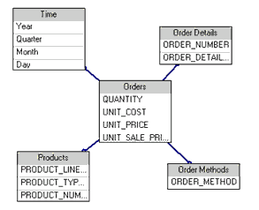
Framework Manager (contd…)
To simplify the model in this example, create a model query subject that combines the foreign keys of both Order Header and Order Details and includes all measures at the Order Detail level. Then create a measure dimension based on the model query subject.
Notes:
Another example to present Creation of Measure Dimension is presented here.
In this case, create a model query subject that combines the foreign keys of both Order Header and Order Details and includes all measures at the Order Detail level. Then create a measure dimension based on the model query subject.

Slide 28
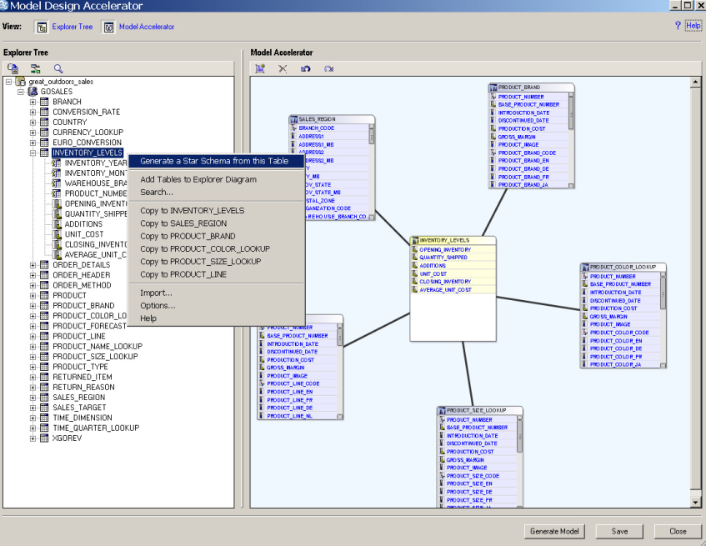
Framework Manager (contd…)
Model Design Accelerator
Visual design tool in Framework Manager for modelers to easily create new models more quickly and leverage proven practices
Key Capabilities
Quick and easy way for new modelers to create
Framework Manager models through a simplified, guided, and automated tool
Provides a jump start to the model design process for experienced modelers, who can then augment models in Framework Manager for more complex requirements
Guides modelers through proven practices and helps to correct and validate common errors
Benefits
Allows new models to easier and quickly build and deploy new models
Expedites the modeling design process through easy, guided and automated model creation
Leverages proven practices to reduce common errors and to improve delivery of models

Slide 29
Framework Manager (contd…)
Model Design Accelerator
Key Facts
Visual design tool to jump start the building of new multi-layer Framework Manager models (from within Framework manager) for creating relational packages only
Allows new modelers to easily create new models more quickly and leverage proven practices…
Work from an empty Star schema template
contains single fact and unlimited associated MQS structures
Modeler adds fact items and MQS items (filling in the blanks)
modeling rules validated as you go… notification rules violated…
The model is generated into a new or current project with only the tables necessary to support the items referenced in the star. Modelers can augment further and for more complex modeling immediately
Target User
New modelers that are looking for an easy and simple way to publish models off of simple and well structured data sources
Advanced modelers are not likely to use it, other than as a “jump start” for creating a new model.
They will then go into Framework Managers afterwards to augment the model

Slide 30
Framework Manager (contd…)
Query Processing Types
Limited Local
Visual design tool to jump start the building of new multi-layer Framework Manager models (from within Framework manager) for creating relational packages only
Allows new modelers to easily create new models more quickly and leverage proven practices.
Database only
The database server does all the SQL processing and execution with the exception of tasks not supported by the database. An error appears if any reports of report sections require local SQL processing.

Slide 31
Cognos Administration
IBM Cognos Business Intelligence administrators ensure that IBM Cognos BI runs smoothly and at its optimum performance
Define Data Source Connection.
Define security permissions for users and groups in the organization.
Manage servers and dispatchers and fine-tune the performance of IBM Cognos BI.
Customize the appearance and functionality of IBM Cognos BI.
Package Deployments.
Scheduling Contents.

Slide 32
Cognos Administration
After IBM Cognos software is installed and configured, you can perform server
administration, data management, security and content administration, activities
management, and portal services administration.
You can also perform the following administrative tasks:
automating tasks
setting up your environment and configuring your database for multilingual reporting
installing fonts
setting up printers
configuring web browsers
allowing user access to Series 7 reports
restricting access to IBM Cognos software

Slide 33
Cognos Security
Introduction About Cognos Security
IBM Cognos software security is designed to meet the need for security in different environments. You can use it in everything from a proof of concept application where security is rarely enabled to a large scale enterprise deployment.
Security in IBM Cognos software is optional. If security is not enabled it means that no authentication providers are configured, and therefore all user access is anonymous. Typically, anonymous users have limited, read-only access.

Slide 34
Cognos Security
Authentication Providers:
User authentication in IBM Cognos software is managed by authentication
Providers. Authentication providers define users, groups, and roles used for
Authentication. User names, IDs, passwords, regional settings, personal
preferences are some examples of information stored in the providers.
If you set up authentication for IBM Cognos software, users must provide valid credentials, such as user ID and password, at logon time. In an IBM Cognos software environment, authentication providers are also referred to as namespaces, and they are represented by namespace entries in the user interface. Manage servers and dispatchers and fine- tune the performance of IBM Cognos BI.
IBM Cognos software does not replicate the users, groups, and roles defined in your authentication provider. However, you can reference them in IBM Cognos software when you set access permissions to reports and other content.

Slide 35
Cognos Security
Authentication Providers:
IBM Cognos components support the following types of servers as authentication sources:
IBM Cognos Series 7 namespace
Active Directory Server
Custom Authentication Provider
LDAP
CA SiteMinder
RACF®
SAP
If you use more than one Content Manager, you must configure identical
authentication providers in each Content Manager location. This means that the type of authentication provider you select and the way you configure it must be identical in all locations for all platforms. The configuration must contain
information that is accessible by all Content Managers.

Slide 36
Cognos Security
Cognos Namespace:
The Cognos namespace is the IBM Cognos software built-in namespace. It contains the IBM Cognos objects, such as groups, roles, data sources, distribution lists, and contacts.
You can rename the Cognos namespace using IBM Cognos Configuration, but you cannot delete it. The namespace is always active.
When you set security in IBM Cognos software, you may want to use the Cognos namespace to create groups and roles that are specific to IBM Cognos software. In this namespace, you can also create security policies that indirectly reference the security entries in authentication providers so that IBM Cognos software can be more easily deployed from one installation to another “Security and Deployment”.

Slide 37
Cognos Security
Initial security:
When a content store is initialized, a set of security objects is created and stored in the Cognos namespace. These objects are designed to simplify the IBM Cognos administration.
The initial security policies grant unrestricted access to all objects in the content store to all users. The security administrator must modify the initial security settings to secure the content store

Slide 38
Cognos Security
Built-in entries:
The built-in entries include the Anonymous user account, the groups All
Authenticated Users and Everyone, and the roles System Administrators and
Tenant Administrators. You cannot delete the built-in entries. They appear in both
secured and non-secured environments.
Anonymous
This entry represents a user account shared by members of the general public who can access IBM Cognos software without being prompted for authentication. For example, this type of access is useful when distributing an online catalog.
You can disable the Anonymous user account by changing the configuration parameters in the configuration tool.

Slide 39
Cognos Security
Built-in entries:
All Authenticated Users
This group represents users who are authenticated by authentication providers. The membership of this group is maintained by the product and cannot be viewed or altered.
Everyone:
This group represents all authenticated users and the Anonymous user account. The membership of this group is maintained by the product and cannot be viewed or altered.

Slide 40
Cognos Security
Built-in entries:
System Administrators
This is a special role in IBM Cognos software. Members of this role are considered root users or super users. They may access and modify any object in the content store, regardless of any security policies set for the object. Only members of the System Administrators role can modify the membership of this role.
The System Administrators role cannot be empty. If you do not want to use System Administrators, you can create an empty group in the Cognos namespace or in your authentication provider, and add this group to the membership of the System Administrators role.

Slide 41
Cognos Security
Predefined entries:
The predefined entries include several IBM Cognos roles. Each role has a specific set of access permissions and can be used to secure different components and functions in IBM Cognos software. You can use the predefined roles, or delete them.
When the predefined roles are created during the content store initialization, the group Everyone is a member of some of them. Some of such roles are Consumers, Query Users, Analysis Users, and Authors. If you want to use the predefined roles, you should modify their initial membership immediately after installing and configuring IBM Cognos software.

Slide 42
Cognos Security
Users, Groups, and Roles:
Users, groups, and roles are created for authentication and authorization purposes.
You can use groups and roles created in IBM Cognos software, and users, groups, and roles created in authentication providers. The groups and roles created in IBM Cognos software are referred to as Cognos groups and Cognos roles.
A user entry is created and maintained in an authentication provider to uniquely identify a human or a computer account. You cannot create user entries in IBM Cognos software.

Slide 43
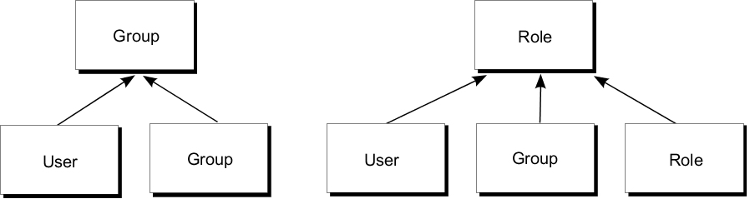
Cognos Security
Users, Groups, and Roles:
Groups and roles represent collections of users that perform similar functions,
or have a similar status in an organization. Examples of groups are Employees,
Developers, or Sales Personnel. Members of groups can be users and other groups. When users log on, they cannot select a group they want to use for a session. They always log on with all the permissions associated with the groups to which they belong.

Slide 44
Q & A

Slide 45
Thank You
Review Date | 14-July-2016
Version | 1.0
Next Review Due | 14-July-2017

